Slide 1

Customer Shopping Behavior Analysis
Uncovering spending patterns, customer segments, and product preferences from 3,900 transactions to guide strategic business decisions.

Slide 2
Dataset at a Glance
3,900
18
37
Purchases
Features
Missing
Rows of transactional data
Columns per record
Review Rating nulls imputed
Key Data Dimensions
Demographics: Age, Gender, Location, Subscription Status
Purchase Details: Category, Amount, Season, Size, Color
Behavior: Discounts, Promo Codes, Frequency, Shipping, Ratings

Slide 3

Data Preparation in Python
01
02
Load & Explore
Clean & Engineer
Imported dataset with pandas; used df.info() and .describe() for structure review.
Imputed missing ratings by category median; created age_group and purchase_frequency_days columns.
03
Standardize & Load
Renamed columns to snake_case; dropped redundant promo_code_used; loaded into PostgreSQL.

Slide 4
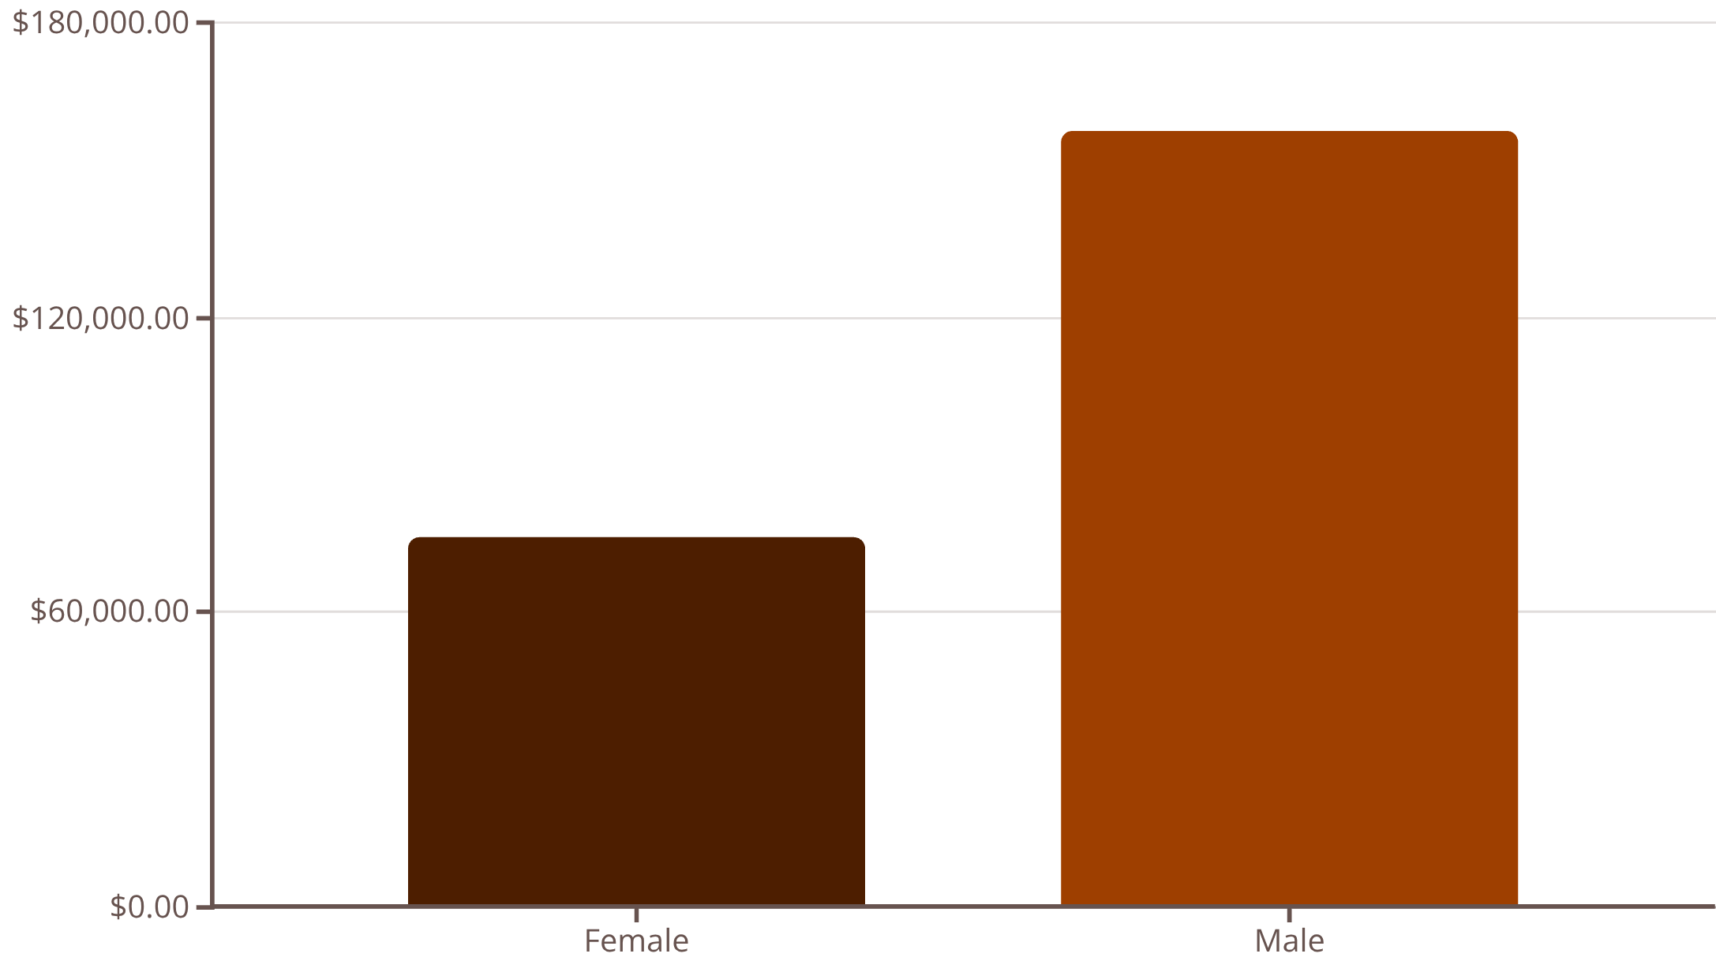
Revenue & Spending Insights
Key Findings
Male customers generated $157,890 vs. female customers' $75,191 — more than double the revenue.
839 discount users still spent above average, proving discounts don't always erode value.
Express shipping users averaged $60.48 vs. Standard at $58.46 — a signal of higher-intent buyers.

Slide 5

Top-Rated Products
1
Gloves
Avg Rating: 3.86
2
Sandals
Avg Rating: 3.84
3
Boots
Avg Rating: 3.82
4
Hat
Avg Rating: 3.80
5
Skirt
Avg Rating: 3.78

Slide 6
Discount-Dependent Products
Highest Discount Rates
These 5 products had the greatest share of discounted purchases — flagging potential margin risk.
50%
49.66%
49.07%
Hat
Sneakers
Coat
48.17%
47.37%
Sweater
Pants

Slide 7
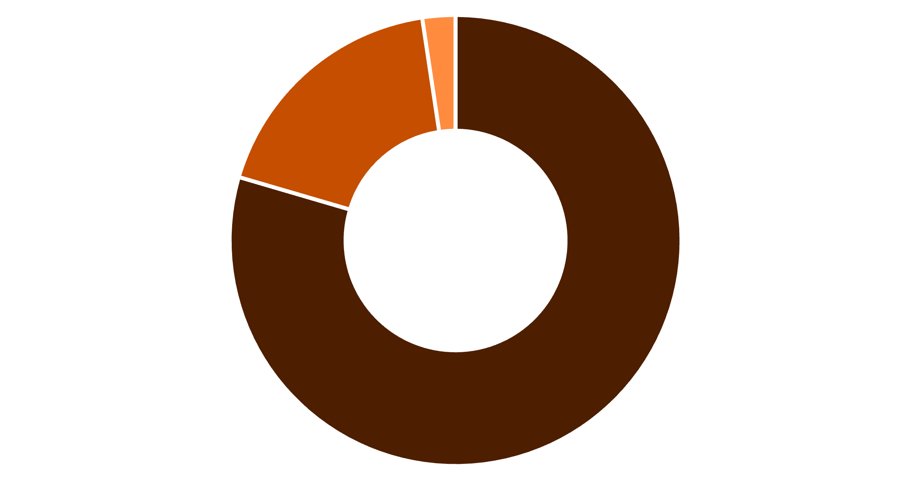
Customer Segmentation
Segment Breakdown
The vast majority — 3,116 customers (80%) — are classified as Loyal, indicating strong retention.
701 Returning customers represent an opportunity to convert into the Loyal tier.
Only 83 New customers suggest acquisition efforts may need reinforcement.
Loyal
Returning
New

Slide 8
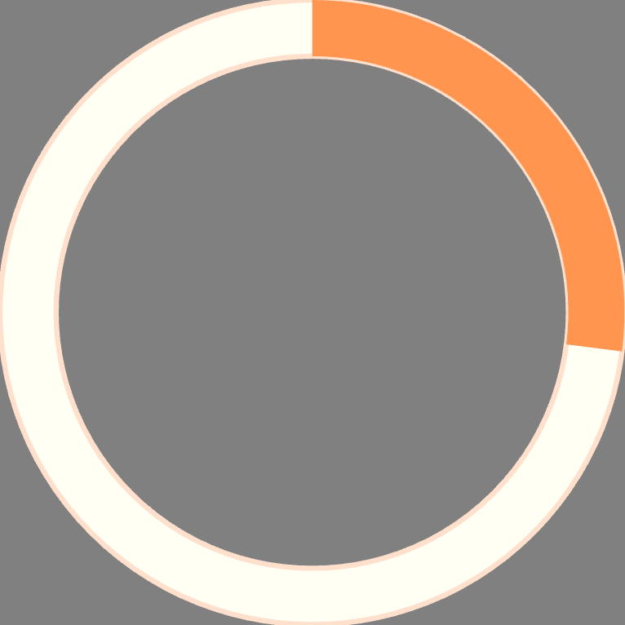

Subscriptions & Age Group Revenue
27%
73%
Subscribers
Non-Subscribers
1,053 customers · Avg spend $59.49
2,847 customers · Avg spend $59.87
Revenue by Age Group
Young Adult
Middle-aged
Adult
Senior
$62,143
$59,197
$55,978
$55,763

Slide 9
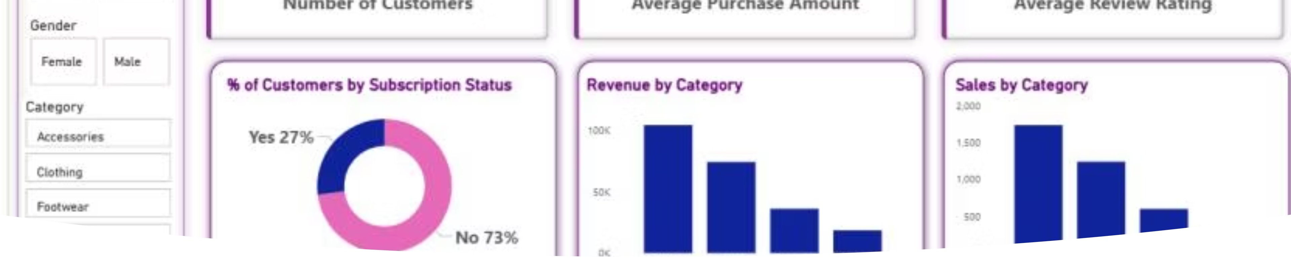
Power BI Dashboard
An interactive dashboard visualizing subscription status, revenue by category (Clothing leads at ~$100K), sales volume, and performance across age groups — enabling real-time business monitoring.

Slide 10

Business Recommendations
Boost Subscriptions
Loyalty Programs
Promote exclusive benefits to grow the 27% subscriber base.
Reward repeat buyers to convert Returning customers into Loyal.
Review Discounts
Targeted Marketing
Balance promotional boosts with margin control on high-discount items.
Focus on Young Adults, top-rated products, and express-shipping users.

